Slide 1
Gender, Race, & Income: Influence on Political Affiliation
Virthiha S., Cordelia T., Dylan H.

Slide 2
What?
Subject:
This research examines the role of demographic factors, specifically gender, race, and income, in shaping political affiliation in the United States. The focus is on understanding how various factors influence whether individuals identify as Democrats or Republicans, in the context of our country’s growing political polarization.
Motivation:
As political divisions in the U.S. intensify, it is essential to explore the underlying demographic influences on political affiliation. Understanding how gender, race, and income shape political identity, voting behaviors, and party loyalty can offer insights that are crucial for predicting future voting patterns, informing political campaigns, and guiding policy decisions.
Research Question:
How do gender, race, and income influence political affiliation (Democrat vs. Republican) in the United States?

Slide 3
How?
Data Set Overview:
National Election Studies (NES) Data - provides detailed demographic information (gender, race, income) along with political affiliation data,
Census Data (American Community Survey) - offers demographic data, including race, gender, income, - can help identify broader population trends
Pew Research Center Survey - Pew conducts regular political surveys that include demographic factors and political preferences, providing valuable insights into how socio-economic factors influence party identification.
Exit Polls Data - from national elections reveal voting patterns across different demographic groups
State-Specific Surveys - regional surveys = localized data
Data processing via:
Data Cleaning - Removing any incomplete or inconsistent data, ensuring accuracy and reliability.
Variable Transformation - Categorizing continuous variables (income) into meaningful groups for easier comparison (like low, medium, high income levels).
Data Integration - Combining data from multiple sources (NES, Census, Pew) into a unified dataset for analysis
R - perform descriptive and inferential statistical analyses (regression models ?)

Slide 4
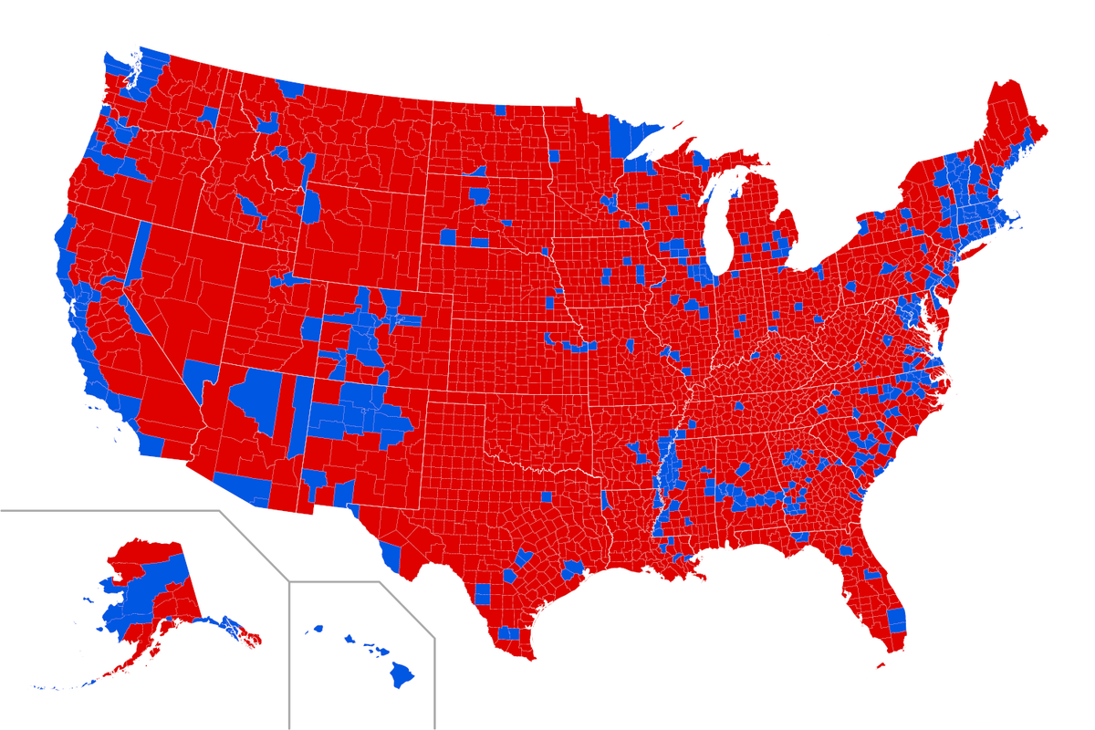
Outcome Variables and Hypotheses
Outcome Variable: Political affiliation (Democrat vs. Republican)
Predictor Variables: Gender, Race, Income
Hypotheses:
H1: Women are more likely to identify as Democrats and men as Republicans
H2: White individuals are more likely to identify as Republicans and racial minorities as Democrats.
H4: Higher income levels are associated with greater likelihood of identifying as Republicans.
2024 Electoral Map

